Slide 1
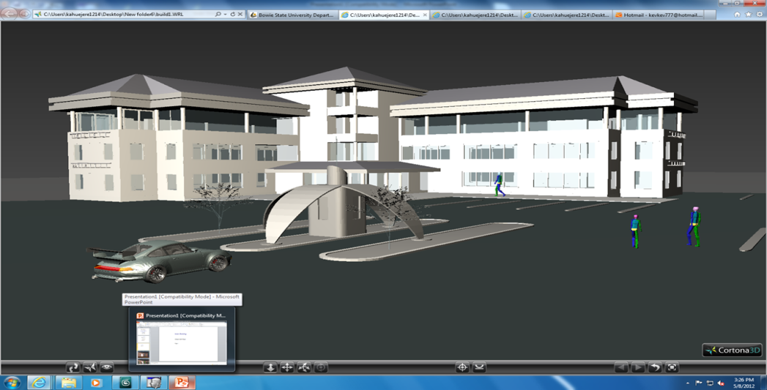
A Virtual Computer Science University
Cosc 729 /Spring 2012
Instructor: Dr. Sharad Sharma
Students:
Kevinson Ahuejere
Timothy Oladunni

Slide 2
Goals And Objective
A virtual Computer Science University:
Gives a prospective students and faculties a proper assessment of the university
Makes the university more accessible to the public

Slide 3
Implementation Tools
Virtual Reality Modeling Language
3DMax Design Application
Virtools 5.0 Design Application
Cortona Web Player

Slide 4
Why virtual reality is the appropriate technology
Immersion
Imagination
Interaction

Slide 5

Computer Science Department Bowie State University
Figure 1 shows the physical structure of the main building.

Slide 6
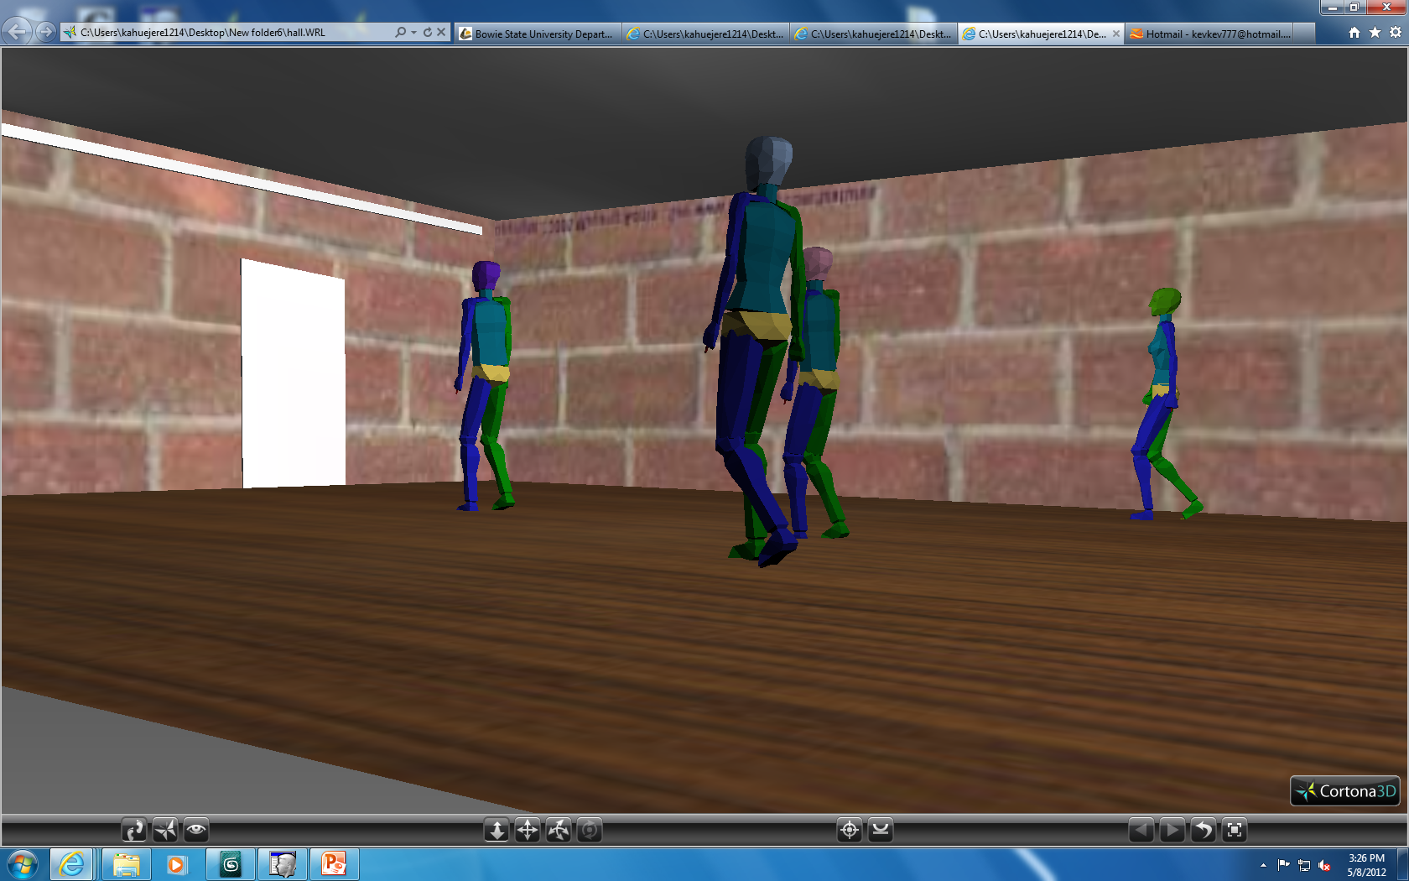
HallWay
Figure 2 shows some students walking on the hallway

Slide 7
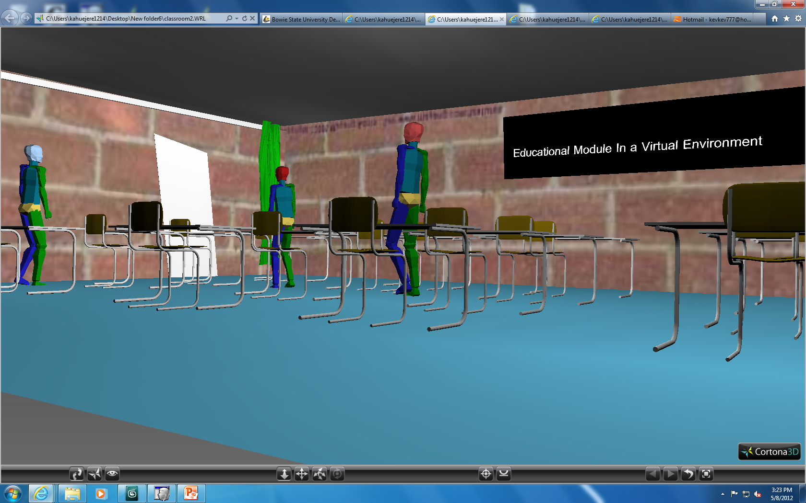
Class Room
Figure 3 shows a classroom

Slide 8
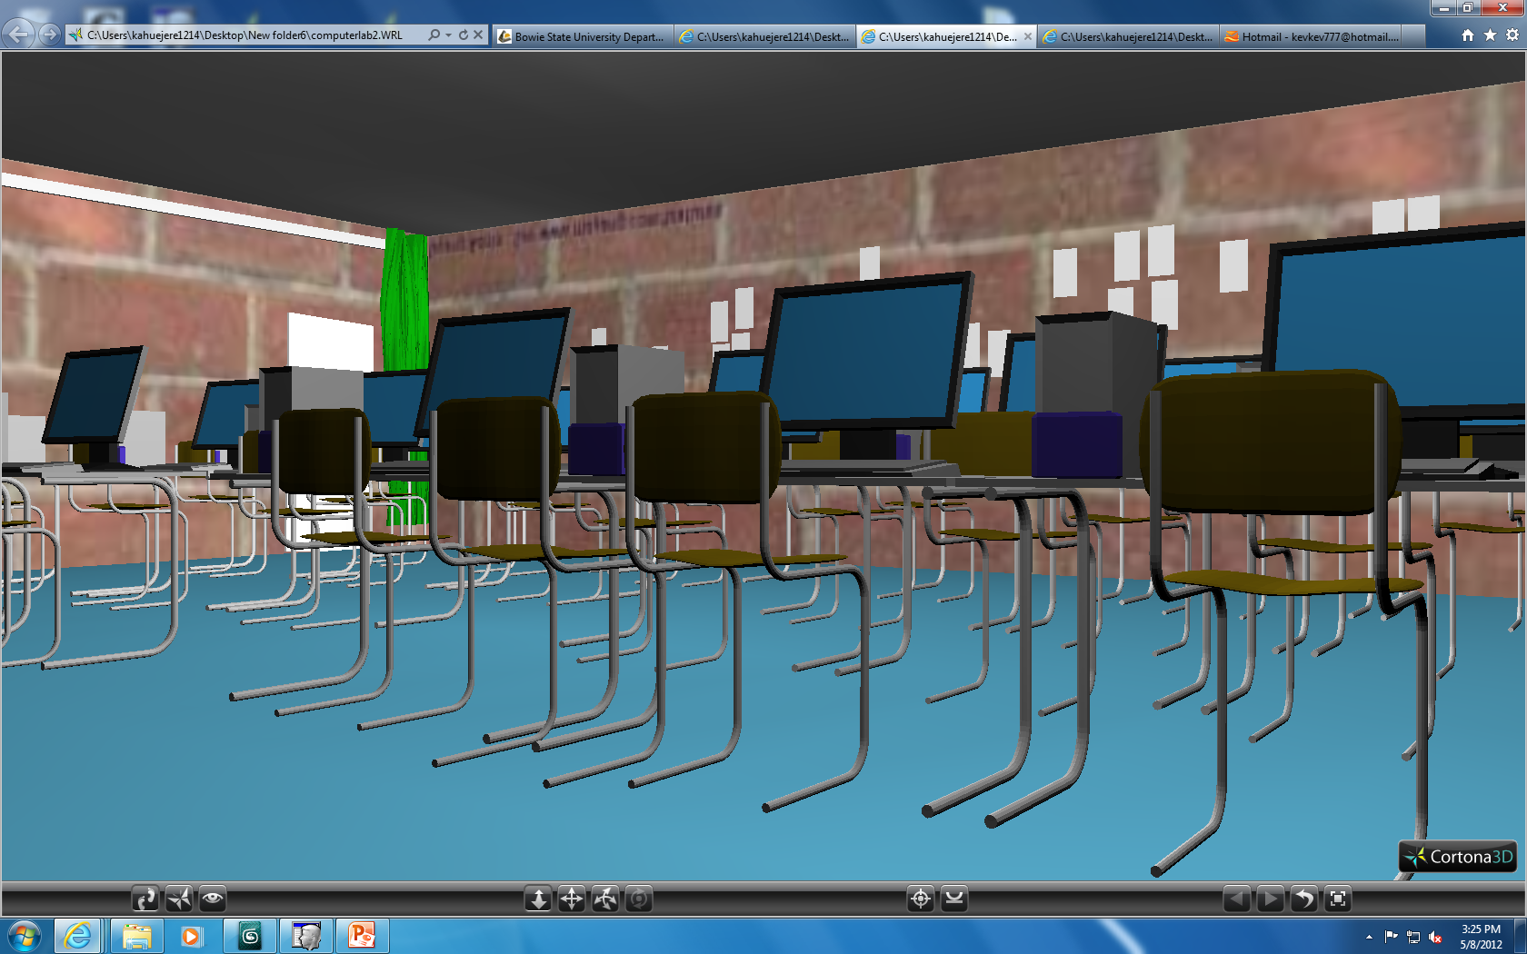
Computer Labs
Fig. 4 shows a computer lab of the university

Slide 9
Problems
These are some of the problems encountered
Time
Limited personnel

Slide 10
Shortcomings
The project only shows one classroom and one laboratory, with more time we could have shown more class rooms and laboratories.

Slide 11
Recommendation
Provision should be made for more students
Office of faculties should be shown

Slide 12
The End

